Slide 1
Genesis: Evolving Optimal Cache Schedule for Diffusion Models
Research Presentation
Optimizing Cache Schedules for Diffusion Models
💡 Improving image generation efficiency
Genesis: Evolving Optimal Cache Schedule for Diffusion Models | --Manuscript Draft-- | Manuscript Number:

Slide 2
Abstract
1/24
Diffusion models have revolutionized image generation by producing very high quality results but their deployment remains constrained by slow inference due to sequential denoising steps.
Training free acceleration methods like DeepCache exploit feature redundancy across timesteps where determining an optimal caching schedule still remains a challenging task.
In this paper, we propose Genesis which is an evolutionary optimization framework that automatically discovers optimal caching schedule using Island Model.

Slide 3
Introduction
2/24
Diffusion models have transformed the field of generation.
Unlike earlier approaches like GANs, which generate output in a single step, diffusion models work by gradually refining noise into meaningful data over multiple timesteps.
This process leads to better image quality and high computational cost.

Slide 4
Related Work
3/24
Diffusion models achieve high-quality generative performance but require iterative denoising steps, making inference slower and more resource intensive.
Early acceleration strategies focused on reducing the number of sampling steps using improved solvers such as DDIM, DPM-Solver.
More recent approaches explore architectural modifications or knowledge distillation to smaller student models; however, these methods require significant computational resources.

Slide 5
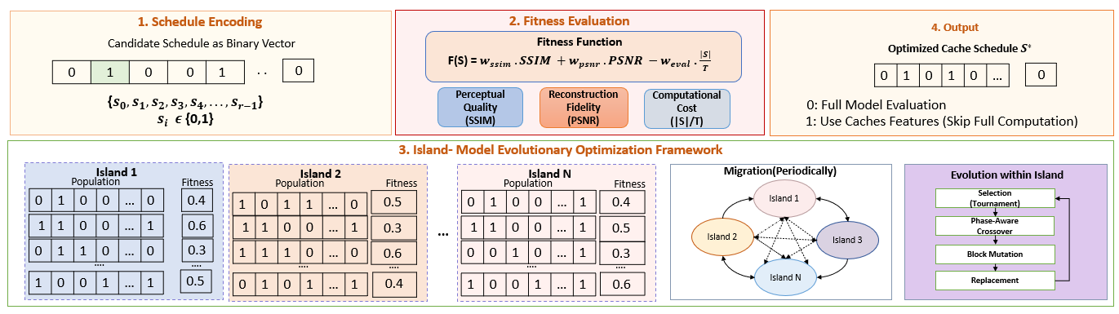
Methodology
4/24
In this paper, we propose an evolutionary optimization framework to improve the caching strategy in diffusion models.
Instead of relying on fixed and uniform caching intervals, our approach searches for adaptive schedules that determine when to perform full computation and when to reuse cached features.
Figure 2: Overview of the proposed evolutionary caching framework for diffusion models. The caching

Slide 6
Problem Formulation
5/24
Diffusion models generate images through a sequential denoising process over T timesteps.
At each timestep, the model refines the image progressively.
We define caching schedule as: S = [s0, s1, …, sk], si ∈ {0, 1, …, T-1} (1)

Slide 7
Background
6/24
Diffusion models are widely known for producing high-quality images.
At higher level, they work by gradually corrupting data and then learning how to reverse that corruption.
In the forward process, noise is added step by step to an image: qt(xt | xt-1) = N(xt; √(1-βt)xt-1, βtI) (3)

Slide 8

Figure 1: Overall Motivation
7/24
Figure 1 illustrates the overall motivation of the proposed

Slide 9
Method
8/24
BOPs↓
MS-COCO (5000 samples)
PartiPrompts[Yu et al. (2022)]
FID↓
CLIP↑
PSNR↑
SSIM↑
CLIP↑
PSNR↑
SSIM↑
PLMS-50 steps
346.96T
25.59
26.89
−
1.000
27.23
−
1.000
PLMS-20 steps
138.78T
24.70
26.74
32.14
0.845
27.04
30.50
0.820
TGATE
130.2T
24.12
26.70
31.85
0.832
26.80
30.25
0.815
Δ-DiT
125.4T
23.95
26.75
32.05
0.840
26.91
30.40
0.818
TokenCache
128.6T
23.80
26.72
31.90
0.835
26.85
30.30
0.816
CacheQuant
4.27T
23.55
26.70
32.10
0.842
26.82
30.45
0.819
DeepCache[Ma et al. (2024)]
133.58T
23.45
26.71
32.45
0.851
26.86
31.10
0.830
Ours (Genesis)
80.00T
20.32
26.83
34.12
0.895
27.12
32.85
0.855

Slide 10
Table 2
9/24
Method | Fitness ↑ | Convergence
Simple GA + Standard Ops Island Model + Standard Ops Simple GA + Proposed Ops Island Model + Proposed Ops | 92.45 94.50 95.25 96.88 | Slow Medium Medium Fast
Table 2

Slide 11
Conclusion
10/24
In this paper, we proposed Genesis, an evolutionary optimization framework that automatically discovers optimal caching schedule using Island Model.
Our approach improves the caching strategy in diffusion models, reducing computational cost and improving image quality.

Slide 12
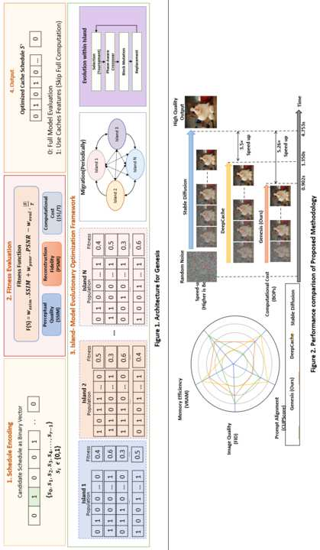
Supplementary Figure
11/24

Slide 13
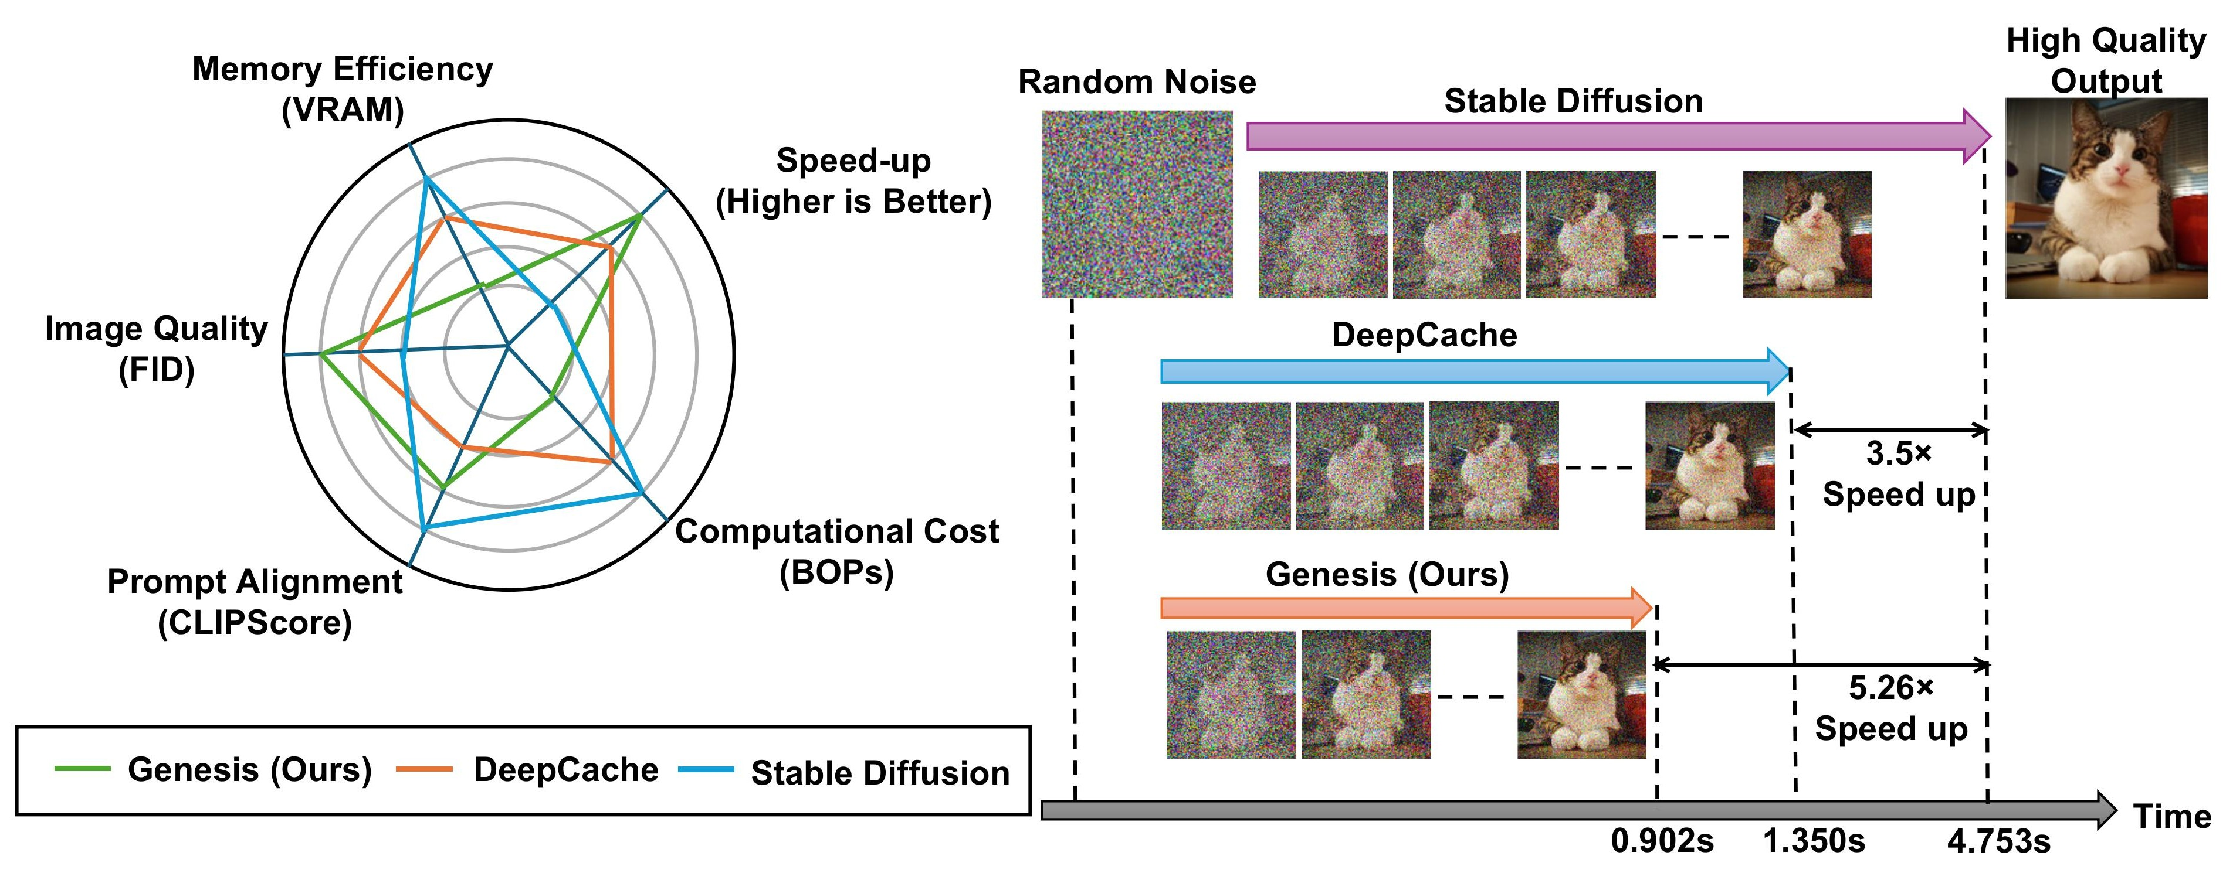
Supplementary Figure
12/24
Figure 1: Comparison of Genesis, DeepCache, and Stable Diffusion. Genesis provides better overall performance across multiple metrics and

Slide 14
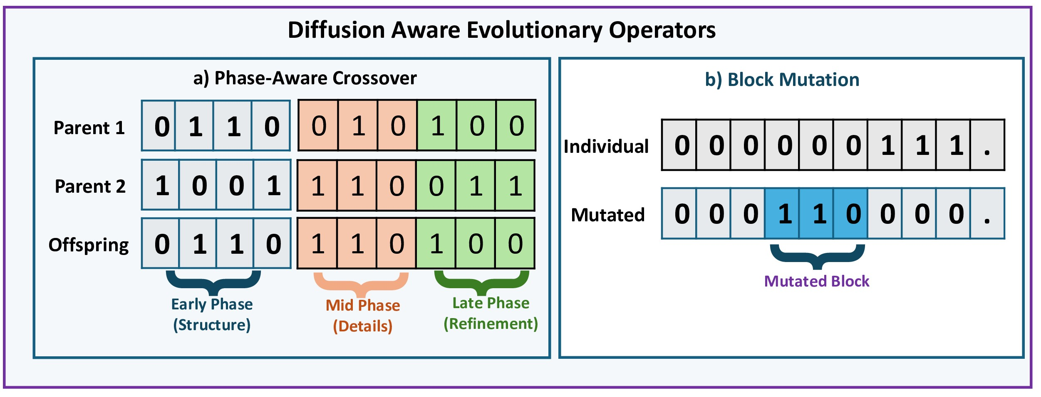
Supplementary Figure
13/24
Figure 2: Overview of the proposed evolutionary caching framework for diffusion models. The caching mechanism selectively reuses backbone

Slide 15
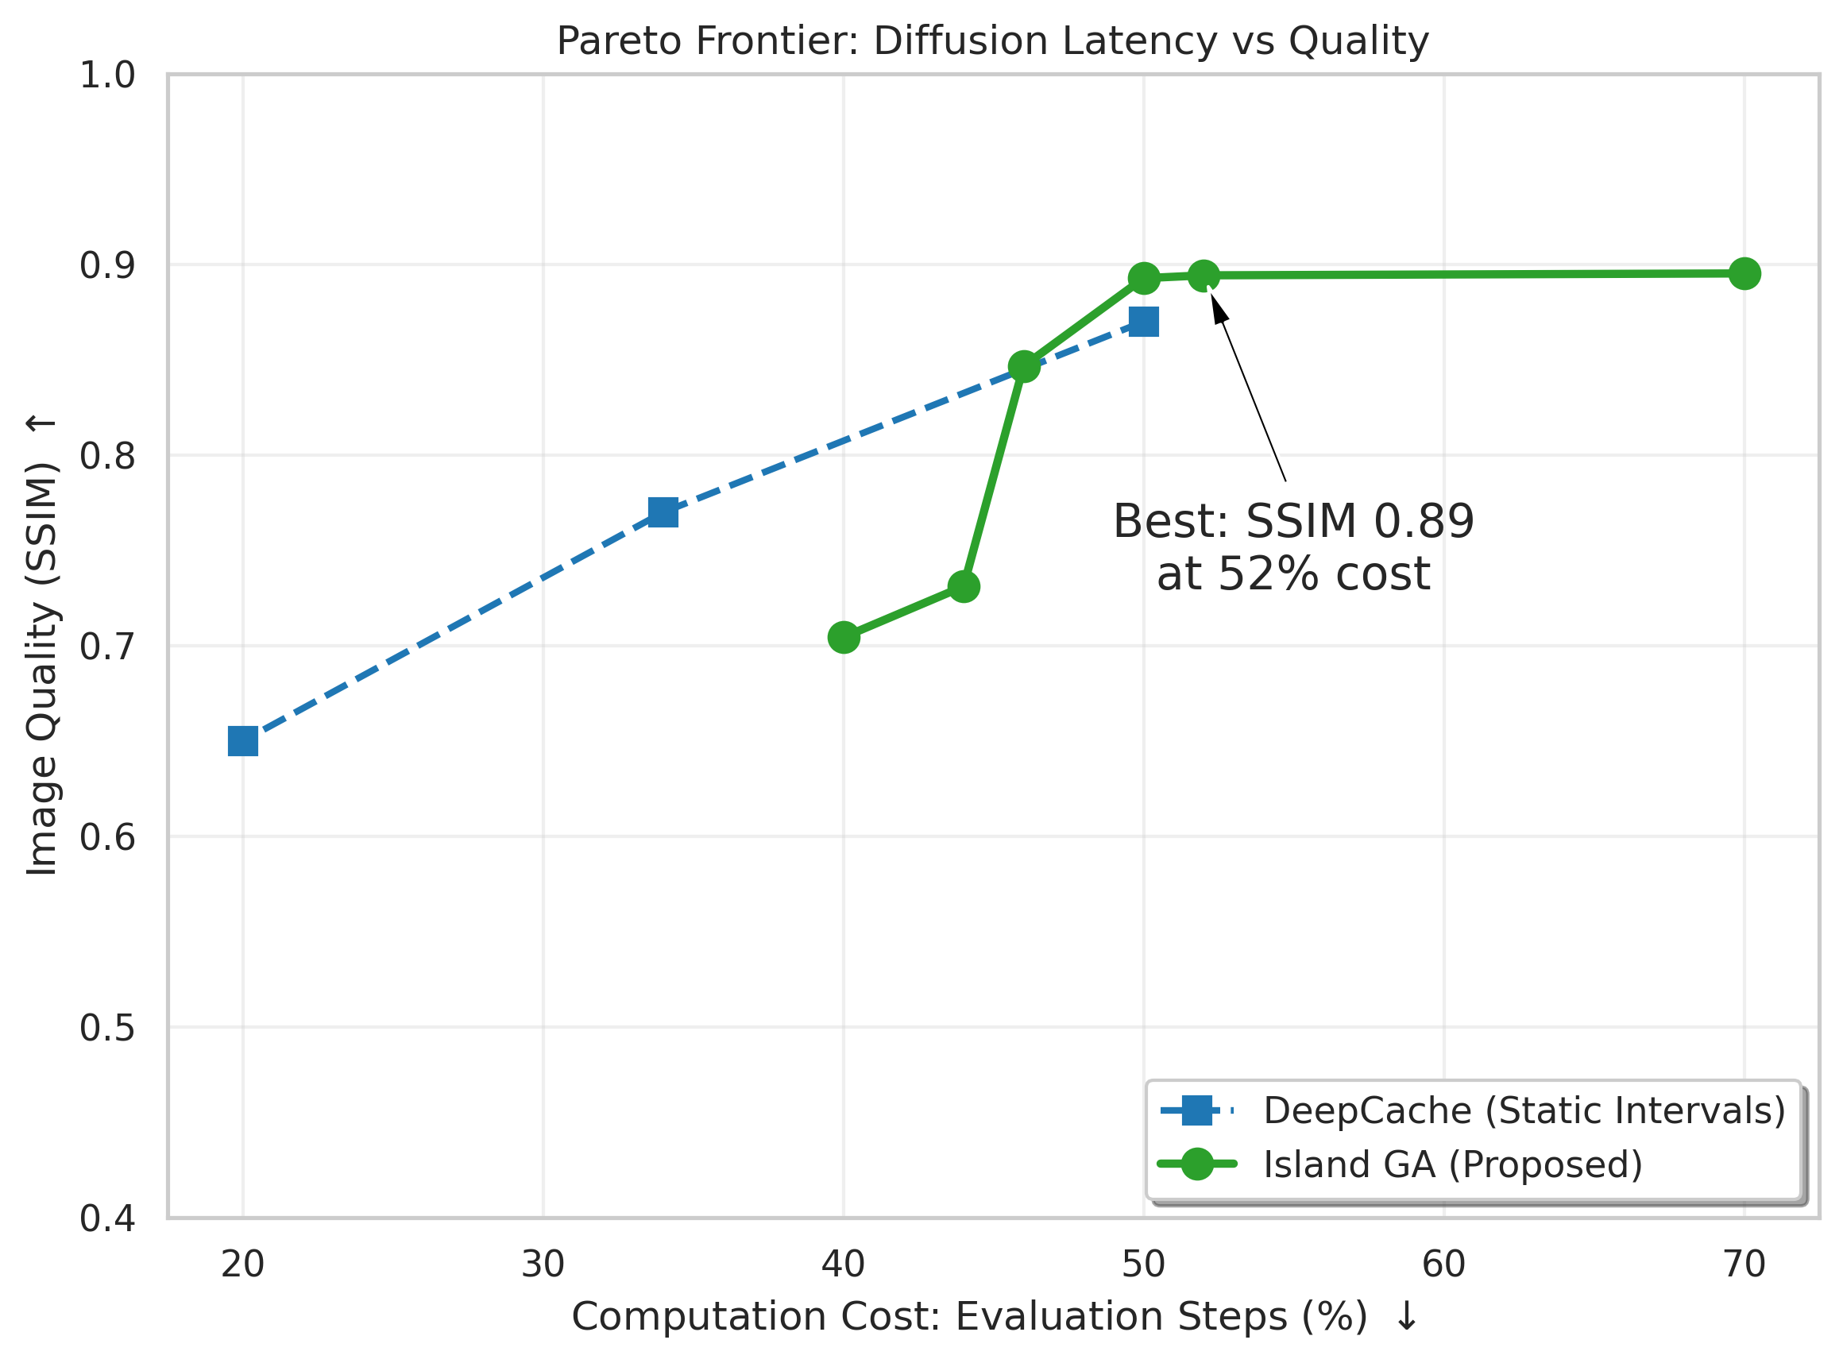
Supplementary Figure
14/24
Figure 4: (Left) Trade-off between inference efficiency and image

Slide 16
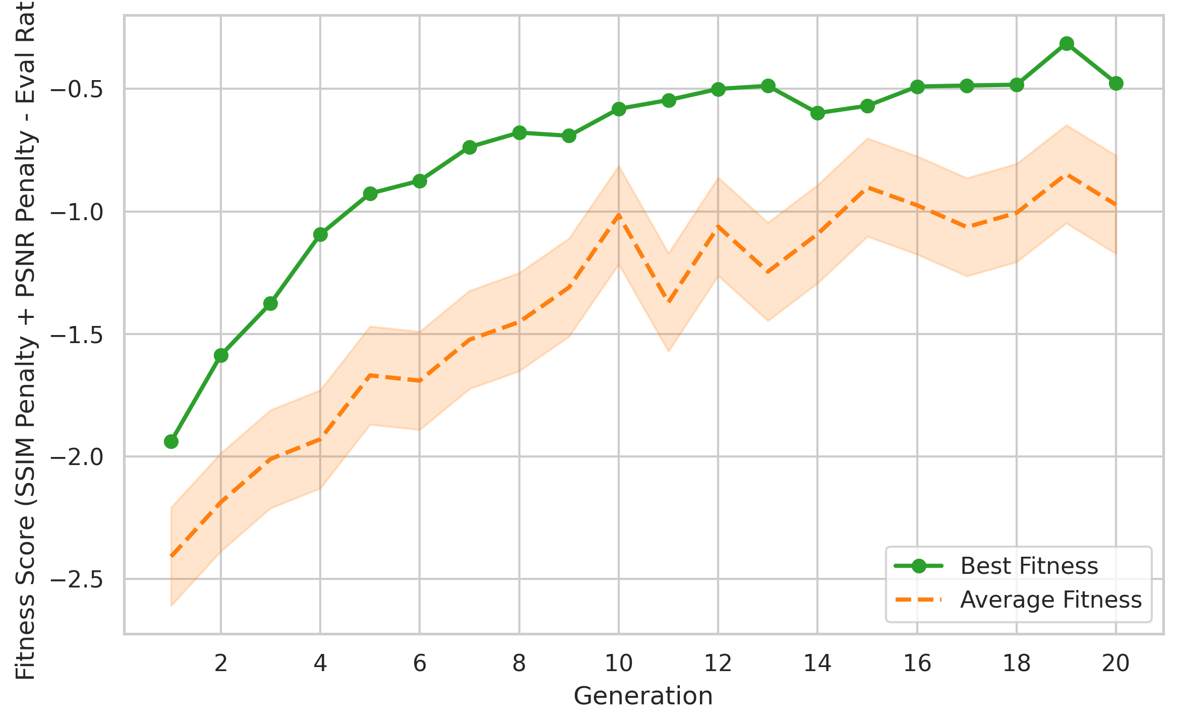
Supplementary Figure
15/24
Figure 4: (Left) Trade-off between inference efficiency and image

Slide 17
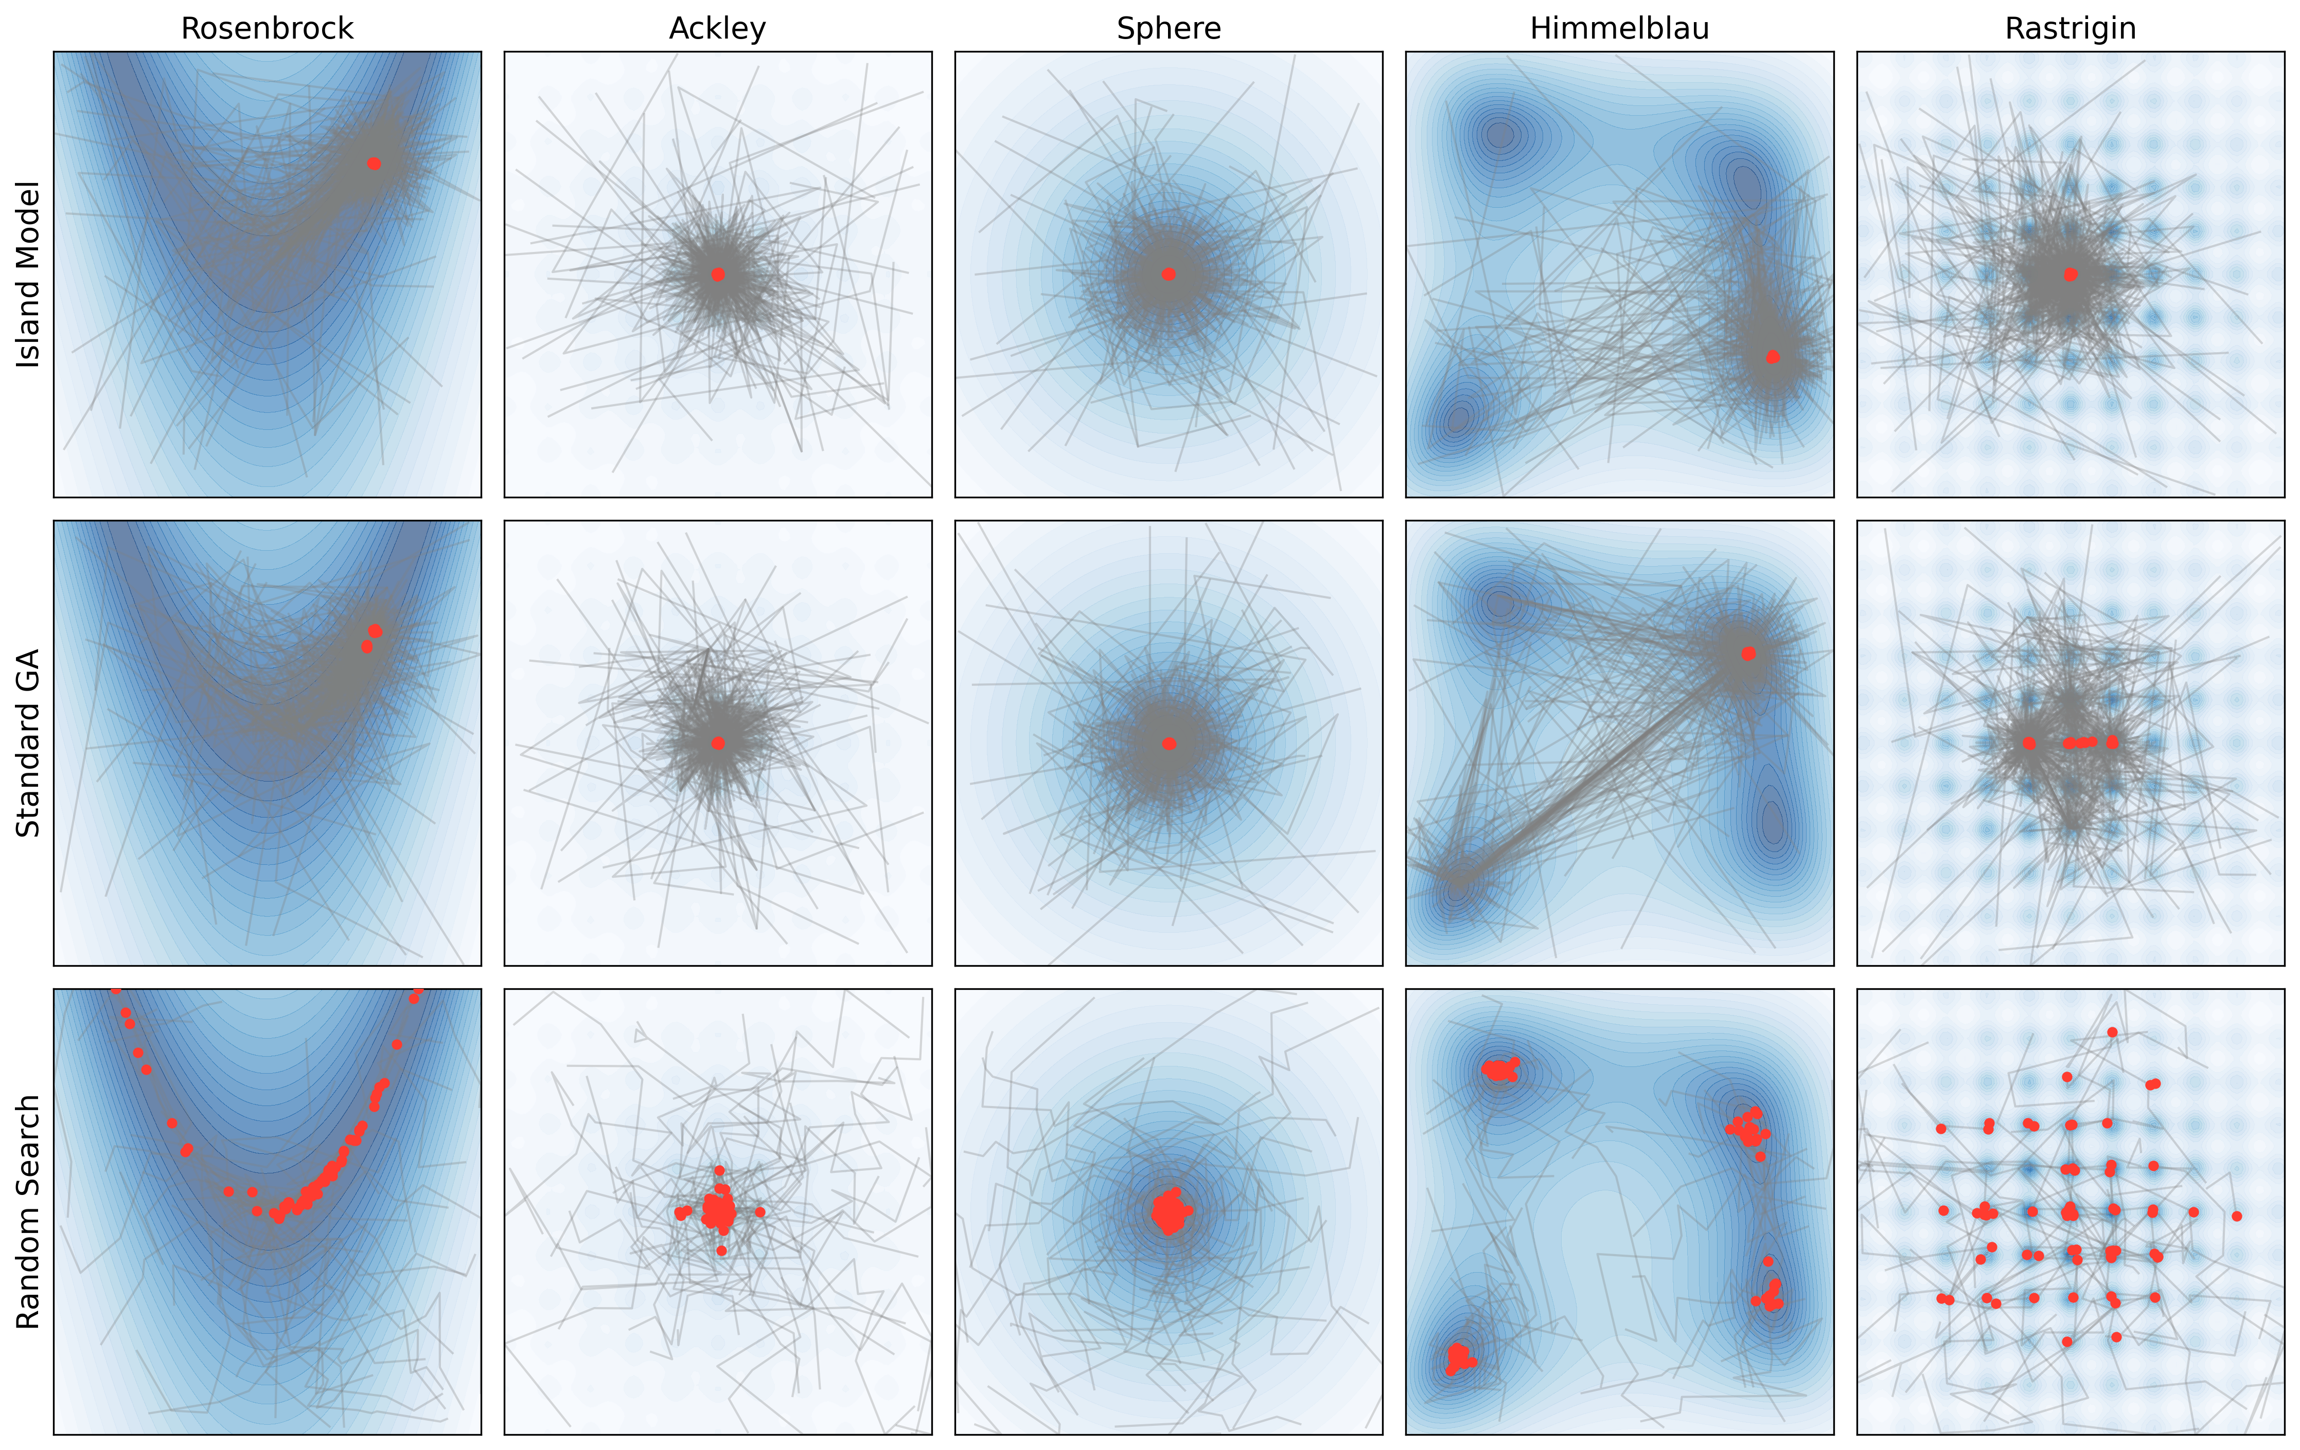
Supplementary Figure
16/24
Figure 5: Optimization trajectories of three search strategies Island Model (top row), Standard Genetic Algorithm (middle row), and Random

Slide 18
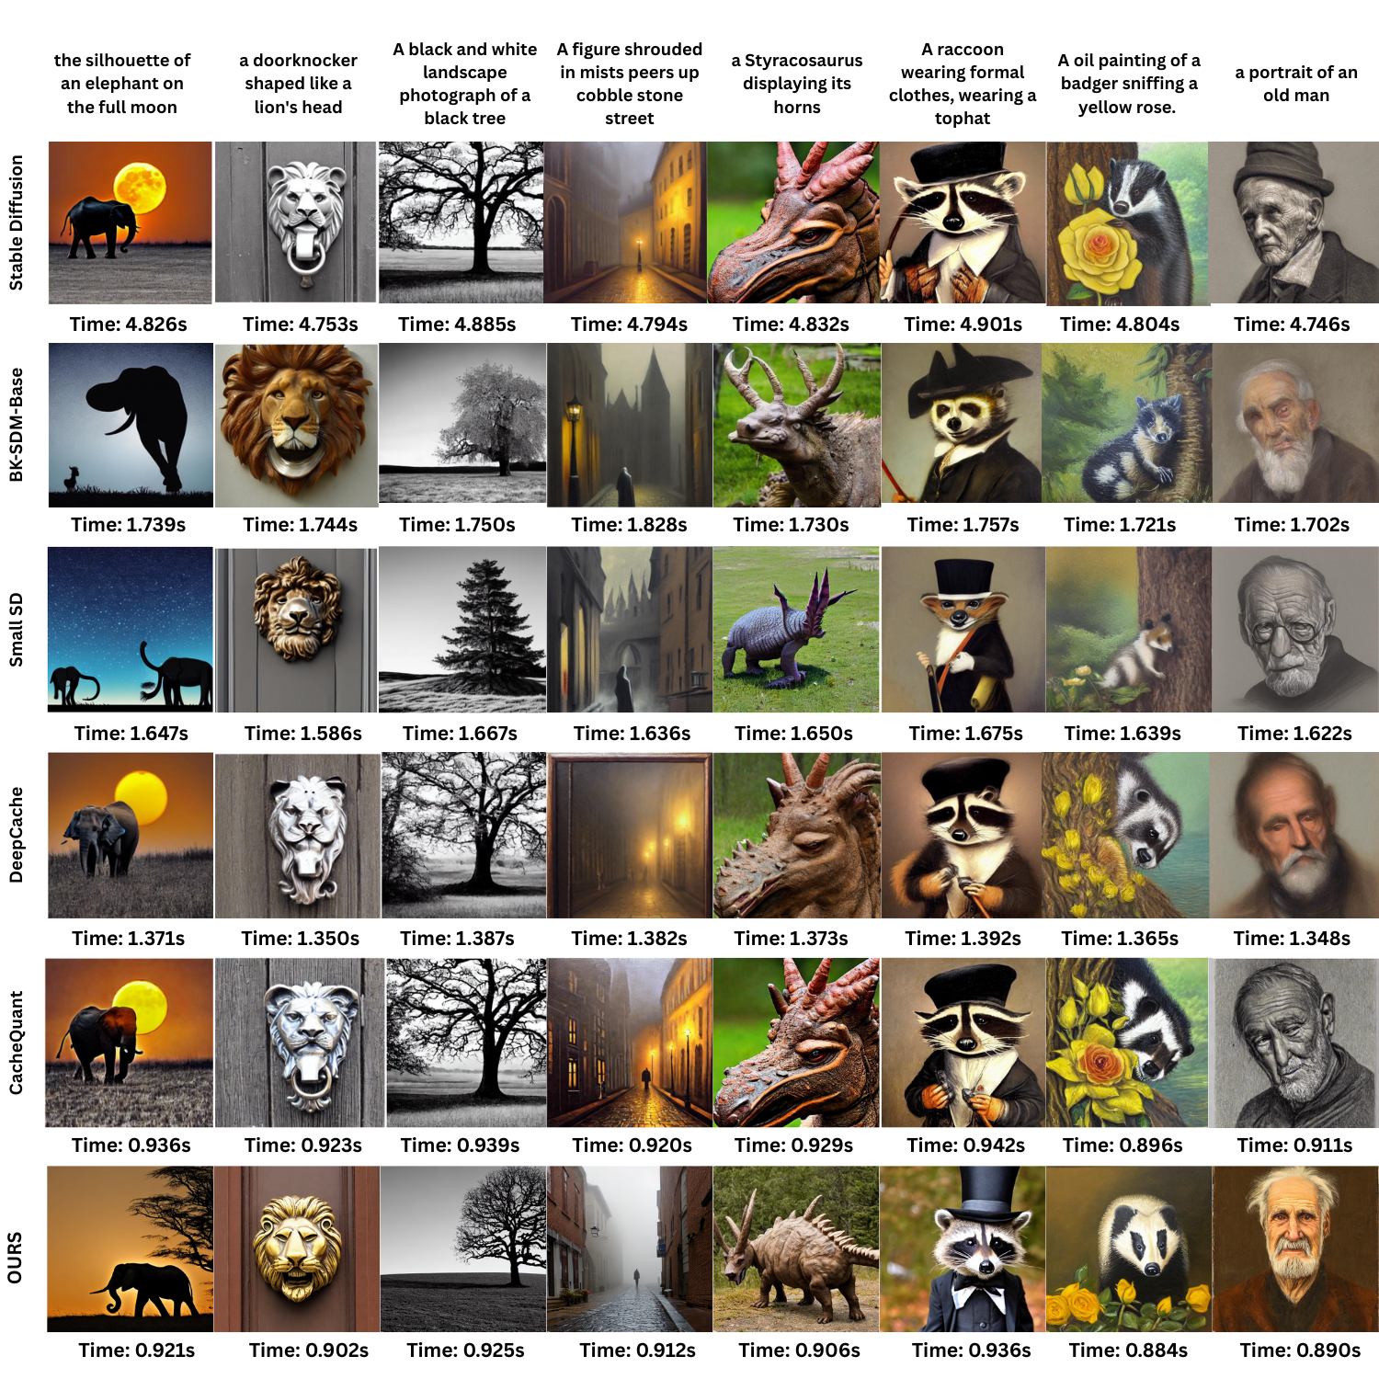
Supplementary Figure
17/24
Figure 6: Qualitative comparison across diffusion models and caching strategies. Images generated from multiple text prompts are shown

Slide 19
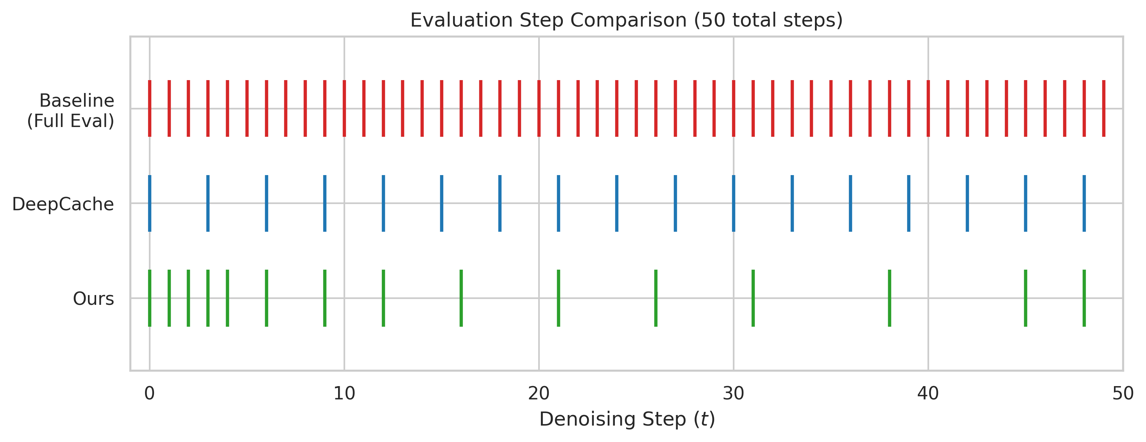
Supplementary Figure
18/24
Figure 7: Comparison of evaluation schedules across 50 denoising

Slide 20
Table 1
19/24
Method | BOPs↓ | MS-COCO (5000 samples) |  |  |  | PartiPrompts[Yu et al. (2022)]
 |  | FID↓ | CLIP↑ | PSNR↑ | SSIM↑ | CLIP↑ | PSNR↑ | SSIM↑
PLMS-50 steps PLMS-20 steps TGATE Δ-DiT TokenCache CacheQuant DeepCache[Ma et al. (2024)] Ours (Genesis) | 346.96T 138.78T 130.2T 125.4T 128.6T 4.27T 133.58T 80.00T | 25.59 24.70 24.12 23.95 23.80 23.55 23.45 20.32 | 26.89 26.74 26.70 26.75 26.72 26.70 26.71 26.83 | − 32.14 31.85 32.05 31.90 32.10 32.45 34.12 | 1.000 0.845 0.832 0.840 0.835 0.842 0.851 0.895 | 27.23 27.04 26.80 26.91 26.85 26.82 26.86 27.12 | − 30.50 30.25 30.40 30.30 30.45 31.10 32.85 | 1.000 0.820 0.815 0.818 0.816 0.819 0.830 0.855
Table 1

Slide 21
Table 3
20/24
Method | Time (s) ↓ | VRAM (GB) ↓
Stable Diffusion DeepCache Ours | 1.00 0.72 0.48 | 14.2 12.5 10.8
Table 3

Slide 22
table 1. Because the Genesis framework is completely modu-
21/24
Method | Time (s) ↓ | VRAM (GB) ↓
Stable Diffusion DeepCache Ours | 1.00 0.72 0.48 | 14.2 12.5 10.8
table 1. Because the Genesis framework is completely modu-

Slide 23
Table 4 presents an ablation analysis of different search
22/24
Method | BOPs↓ | MS-COCO (5000 samples) |  |  |  | PartiPrompts[Yu et al. (2022)]
 |  | FID↓ | CLIP↑ | PSNR↑ | SSIM↑ | CLIP↑ | PSNR↑ | SSIM↑
PLMS-50 steps PLMS-20 steps TGATE Δ-DiT TokenCache CacheQuant DeepCache[Ma et al. (2024)] Ours (Genesis) | 346.96T 138.78T 130.2T 125.4T 128.6T 4.27T 133.58T 80.00T | 25.59 24.70 24.12 23.95 23.80 23.55 23.45 20.32 | 26.89 26.74 26.70 26.75 26.72 26.70 26.71 26.83 | − 32.14 31.85 32.05 31.90 32.10 32.45 34.12 | 1.000 0.845 0.832 0.840 0.835 0.842 0.851 0.895 | 27.23 27.04 26.80 26.91 26.85 26.82 26.86 27.12 | − 30.50 30.25 30.40 30.30 30.45 31.10 32.85 | 1.000 0.820 0.815 0.818 0.816 0.819 0.830 0.855
Table 4 presents an ablation analysis of different search

Slide 24
Table 1 shows that Genesis reduces the computational
23/24
Task |  | Random Search | Standard GA | Island Model
Fitness |  | 84.102 | 92.4501 | 96.882
Error | Sphere Ackley Rastrigin | 12.45 19.12 145.20 | 0.05 3.02 45.21 | 0.0014 0.84 12.10
Table 1 shows that Genesis reduces the computational

Slide 25
Table 4
24/24
Task |  | Random Search | Standard GA | Island Model
Fitness |  | 84.102 | 92.4501 | 96.882
Error | Sphere Ackley Rastrigin | 12.45 19.12 145.20 | 0.05 3.02 45.21 | 0.0014 0.84 12.10
Table 4

Slide 26
Thank You
Genesis: Evolving Optimal Cache Schedule for Diffusion Models | --Manuscript Draft-- | Manuscript Number:

